Slide 1

ISMS implementation and certification process overview

Slide 2
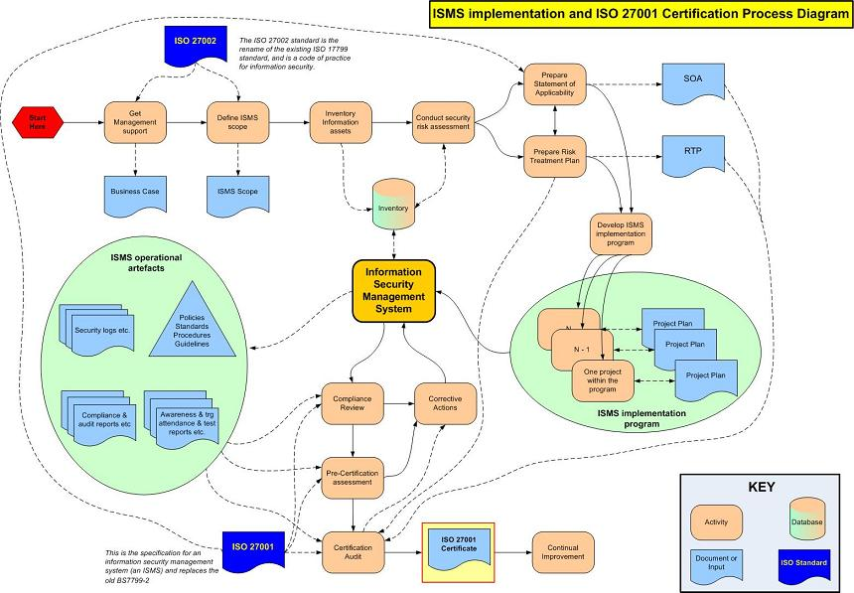
ISO27001 - Roadmap

Slide 3
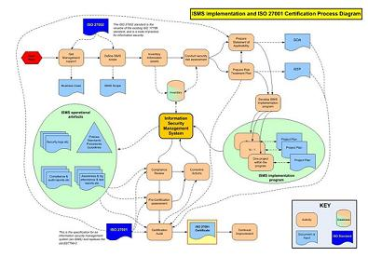
ISO27001
ISO27001 formally specifies how to establish an Information Security Management System (ISMS).
The adoption of an ISMS is a strategic decision.
The design and implementation of an organization’s ISMS is influenced by its business and security objectives, its security risks and control requirements, the processes employed and the size and structure of the organization: a simple situation requires a simple ISMS.
The ISMS will evolve systematically in response to changing risks.
Compliance with ISO27001 can be formally assessed and certified. A certified ISMS builds confidence in the organization’s approach to information security management among stakeholders.
ISO27001

Slide 4
ISO27002
ISO27002 is a “Code of Practice” recommending a large number of information security controls.
Control objectives throughout the standard are generic, high-level statements of business requirements for securing or protecting information assets.
The numerous information security controls recommended by the standard are meant to be implemented in the context of an ISMS, in order to address risks and satisfy applicable control objectives systematically.
Compliance with ISO27002 implies that the organization has adopted a comprehensive, good practice approach to securing information.
ISO27002

Slide 5
Management Support
Management should actively support information security by giving clear direction (e.g. policies), demonstrating the organization’s commitment, plus explicitly assigning information security responsibilities to suitable people.
Management should approve the information security policy, allocate resources, assign security roles and co-ordinate and review the implementation of security across the organization.
Overt management support makes information security more effective throughout the organization, not least by aligning it with business and strategic objectives.
Management
support is vital

Slide 6
Defining ISMS scope
Management should define the scope of the ISMS in terms of the nature of the business, the organization, its location, information assets and technologies.
Any exclusions from the ISMS scope should be justified and documented.
Areas outside the ISMS are inherently less trustworthy, hence additional security controls may be needed for any business processes passing information across the boundary.
De-scoping usually reduces the business benefits of the ISMS.
If commonplace controls are deemed not applicable, this should be justified and documented in the Statement of Applicability (SOA)
The certification auditors will check the documentation.
Define ISMS
scope

Slide 7
Inventory of Assets
An inventory of all important information assets should be developed and maintained, recording details such as:
Type of asset;
Format (i.e. software, physical/printed, services, people, intangibles)
Location;
Backup information;
License information;
Business value (e.g. what business processes depend on it?).
Inventory information
assets
Notes:
There are many types of assets, including:
a) Information: databases and data files, contracts and agreements, system documentation, research information, user manuals, training material, operational or support procedures, business continuity plans, fallback arrangements, audit trails, and archived information;
b) Software assets: application software, system software, development tools, and utilities;
c) Physical assets: computer equipment, communications equipment, removable media, and other equipment;
d) Services: computing and communications services, general utilities, e.g. heating, lighting, power, and air-conditioning;
e) People, and their qualifications, skills, and experience;
f) Intangibles, such as reputation and image of the organization.

Slide 8
Risk Assessment
Risk assessments should identify, quantify, and prioritize information security risks against defined criteria for risk acceptance and objectives relevant to the organization.
The results should guide and determine the appropriate management action and priorities for managing information security risks and for implementing controls selected to protect against these risks.
Assessing risks and selecting controls may need to be performed repeatedly across different parts of the organization and information systems, and to respond to changes.
The process should systematically estimate the magnitude of risks (risk analysis) and compare risks against risk criteria to determine their significance (risk evaluation).
The information security risk assessment should have a clearly defined scope and complement risk assessments in other aspects of the business, where appropriate.
Assess information security risks
Notes:
See page 80 to Reference C

Slide 9
Prepare Statement of Applicability
The Statement of Applicability (SOA) is a key ISMS document listing the organization’s information security control objectives and controls.
The SOA is derived from the results of the risk assessment, where:
Risk treatments have been selected;
All relevant legal and regulatory requirements have been identified;
Contractual obligations are fully understood;
A review the organization’s own business needs and requirements has been carried out.
SOA

Slide 10
Prepare Risk Treatment Plan
The organisation should formulate a risk treatment plan (RTP) identifying the appropriate management actions, resources, responsibilities and priorities for dealing with its information security risks.
The RTP should be set within the context of the organization's information security policy and should clearly identify the approach to risk and the criteria for accepting risk.
The RTP is the key document that links all four phases of the PDCA cycle for the ISMS (next 2 slides).
Prepare Risk
Treatment Plan
Notes:
See pages 97/98 to Reference C

Slide 11
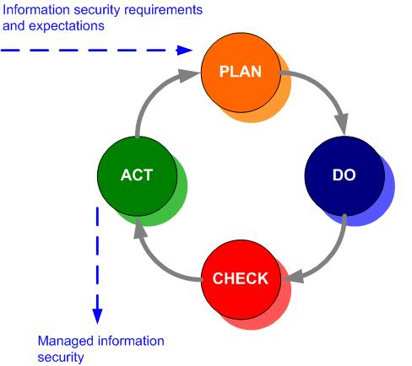
PDCA Model
The "Plan-Do-Check-Act" (PDCA) model applies at different levels throughout the ISMS (cycles within cycles).
The same approach is used for quality management in ISO9000.
The diagram illustrates how an ISMS takes as input the information security requirements and expectations and through the PDCA cycle produces managed information security outcomes that satisfy those requirements and expectations.

Slide 12
PDCA Model
Plan (establish the ISMS)
Establish ISMS policy, objectives, processes and procedures relevant to managing risk and improving information security to deliver results in accordance with an organization’s overall policies and objectives.
Do (implement and operate the ISMS)
Implement and operate the ISMS policy, controls, processes and procedures.
Check (monitor and review the ISMS)
Assess and, where applicable, measure process performance against ISMS policy, objectives and practical experience and report the results to management for review.
Act (maintain and improve the ISMS)
Take corrective and preventive actions, based on the results of the internal ISMS audit and management review or other relevant information, to achieve continual improvement of the ISMS.

Slide 13
ISMS Implementation Programme
Implement the Risk Treatment Plan in order to achieve the identified control objectives, which includes consideration of funding and allocation of roles and responsibilities.
Implement controls selected during establishing the ISMS to meet the control objectives.
Define how to measure the effectiveness of controls to allows managers and staff to determine how well controls achieve planned control objectives.
Implement security training and awareness programmes.
Implement the
programme

Slide 14
The ISMS
It is important to be able to demonstrate the relationship from the selected controls back to the risk assessment and risk treatment process, and subsequently back to the ISMS policy and objectives.
ISMS documentation should include:
Documented statements of the ISMS policy and objectives;
The scope of the ISMS;
Procedures and other controls in support of the ISMS;
A description of the risk assessment methodology;
A risk assessment report and Risk Treatment Plan (RTP);
Procedures for effective planning, operation and control of the information security processes, describing how to measure the effectiveness of controls;
Various records specifically required by the standard;
The Statement of Applicability (SOA).
Information Security
Management
System (ISMS)

Slide 15
Compliance Review and Corrective Actions
Management must review the organization’s ISMS at least once a year to ensure its continuing suitability, adequacy and effectiveness.
They must assess opportunities for improvement and the need for changes to the ISMS, including the information security policy and information security objectives.
The results of these reviews must be clearly documented and maintained (“records”).
Reviews are part of the ‘Check’ phase of the PDCA cycle: any corrective actions arising must be managed accordingly.
Compliance
Review
Corrective actions

Slide 16
Pre-Certification Assessment
Prior to certification, the organization should carry out a comprehensive review of the ISMS and SOA.
The organization will need to demonstrate compliance with both the full PDCA cycle and clause 8 of ISO27001, the requirement for continual improvement.
Certification auditors will seek evidence (in the form of records of processes such as risk assessments, management reviews, incident reports, corrective actions etc.) that the ISMS is operating and continually improving.
The ISMS therefore needs a while to settle down, operate normally and generate the records after it has been implemented.
Pre-Certification
Assessment

Slide 17
Certification Audit
Certification involves the organization’s ISMS being assessed for compliance with ISO27001.
The certification body needs to gain assurance that the organization’s information security risk assessment properly reflects its business activities for the full scope of the ISMS.
The assessors will check that the organization has properly analysed and treated its information security risks and continues managing its information security risks systematically.
A certificate of compliance from an accredited certification body has credibility with other organizations
Certification
Audit

Slide 18
Certification Audit
The organization shall continually improve the effectiveness of the ISMS through the use of:
The information security policy;
Information security objectives;
Audit results;
Analysis of monitored events;
Corrective and preventive actions;
Management review.
Continual
Improvement

Slide 19
References
ISO/IEC 27001:2005. Information Technology - Security Techniques – Information Security Management Systems – Requirements. Known as ISO 27001.
ISO/IEC 27002:2005. Information Technology - Security Techniques - Code of Practice for Information Security Management. Known as ISO 27002.
Alan Calder & Steve Watkins (2012). IT Governance: an International Guide to Data Security and ISO27001/ISO27002. 5th edition. Kogan Page Publishing.

Slide 20
Further information
Retrac Consulting provides consultancy advice on the provision of an Information Assurance regime for an organisation to protect their information assets, data and systems on which the data is stored, processed and transmitted. This is achieved through the assessment of threats to information systems, an analysis of the vulnerabilities that might be exploited by those threats, an understanding of the impact of identified risks, and the application of technical and non-technical countermeasures to reduce those risks to an acceptable level for the business.
Marty Carter MBCS CITP
Managing Director
Retrac Consulting Ltd
Tel: +44 (0) 7920 074261
Fax: +44 (0) 1242 292003
Email: information@retrac-consulting.co.uk
Web: www.retrac-consulting.co.uk

Slide 21
Copyright
This work is copyright © 2010, ISO27k Forum, some rights reserved. It is licensed under the Creative Commons Attribution-Noncommercial-Share Alike 3.0 License. You are welcome to reproduce, circulate, use and create derivative works from this provided that:
It is not sold or incorporated into a commercial product;
It is properly attributed to the ISO27k Forum at www.ISO27001security.com; and
If shared, derivative works are shared under the same terms as this.

